Slide 1
DevDays Europe
DevDays Europe Europe conferences, held from May 21 to 23, 2025, in Vilnius, Lithuania

Slide 2
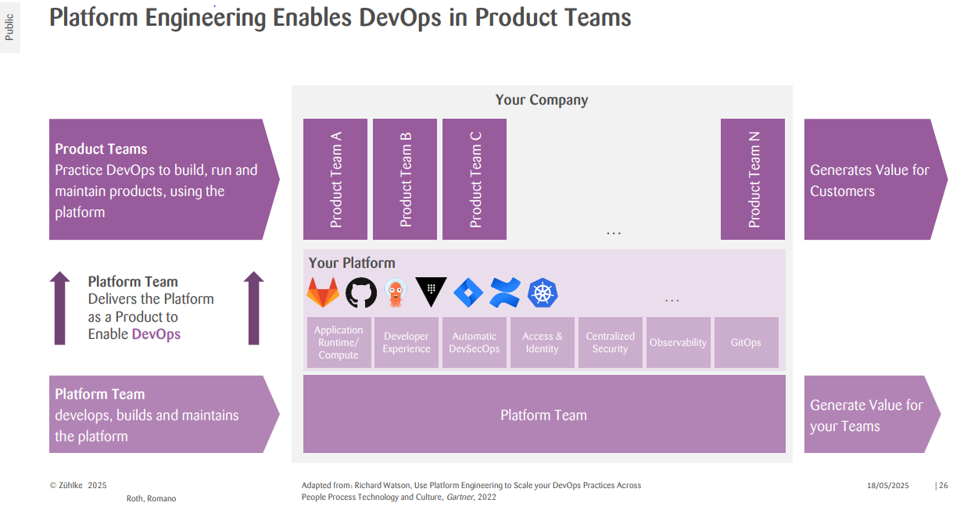
AI-Augmented DevOps with Platform Engineering, by Romano Roth

Slide 3
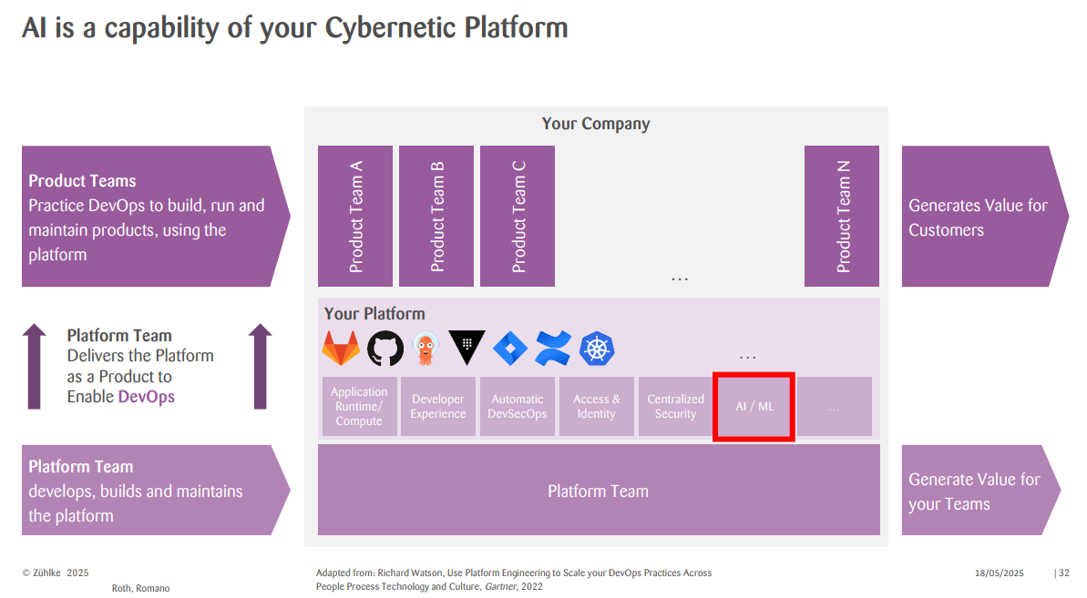
AI-Augmented DevOps with Platform Engineering, by Romano Roth
Quantum
computing

Slide 4
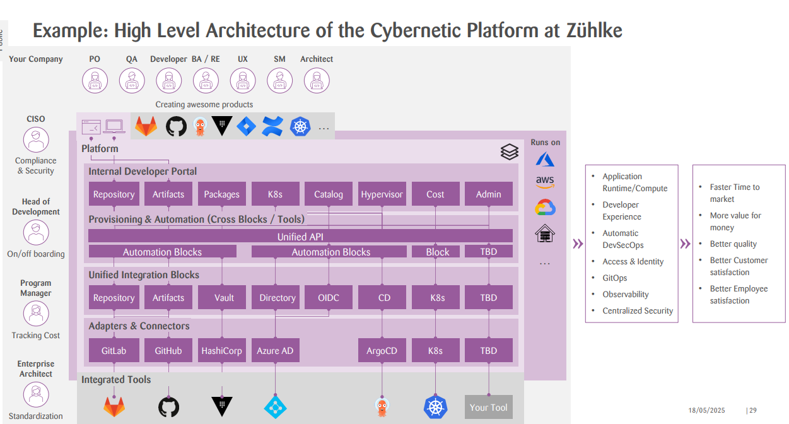
AI-Augmented DevOps with Platform Engineering, by Romano Roth

Slide 5
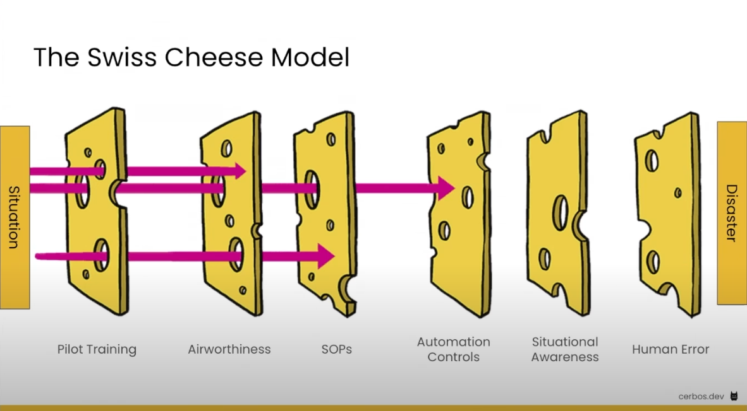
Layered Security: What Aviation Safety and Cheese Can Teach Us About Zero Trust, by Alex Olivier

Slide 6
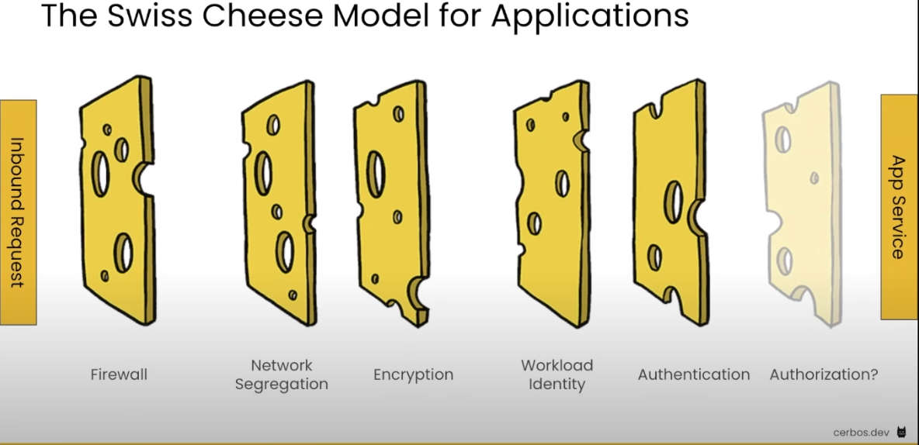
Layered Security: What Aviation Safety and Cheese Can Teach Us About Zero Trust, by Alex Olivier

Slide 7
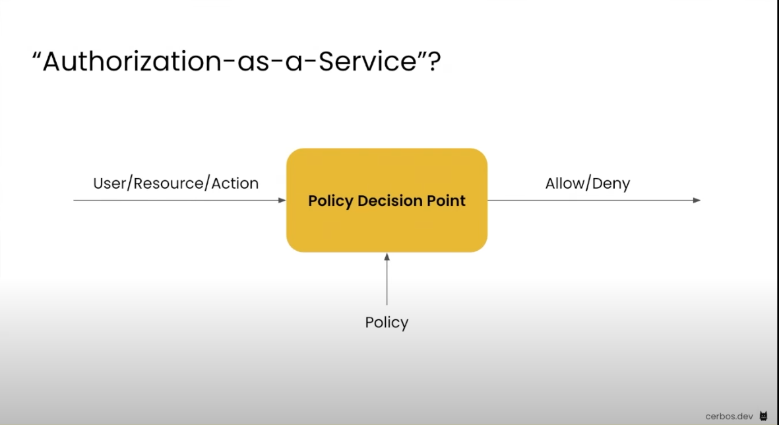
Layered Security: What Aviation Safety and Cheese Can Teach Us About Zero Trust, by Alex Olivier

Slide 8
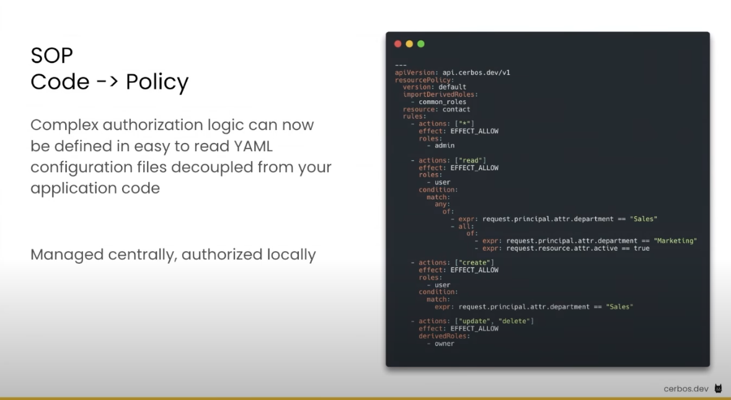
Layered Security: What Aviation Safety and Cheese Can Teach Us About Zero Trust, by Alex Olivier

Slide 9
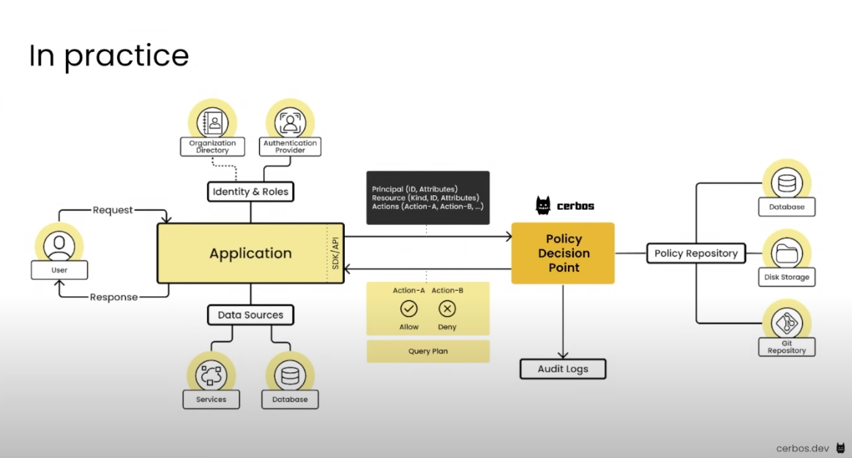
Layered Security: What Aviation Safety and Cheese Can Teach Us About Zero Trust, by Alex Olivier

Slide 10
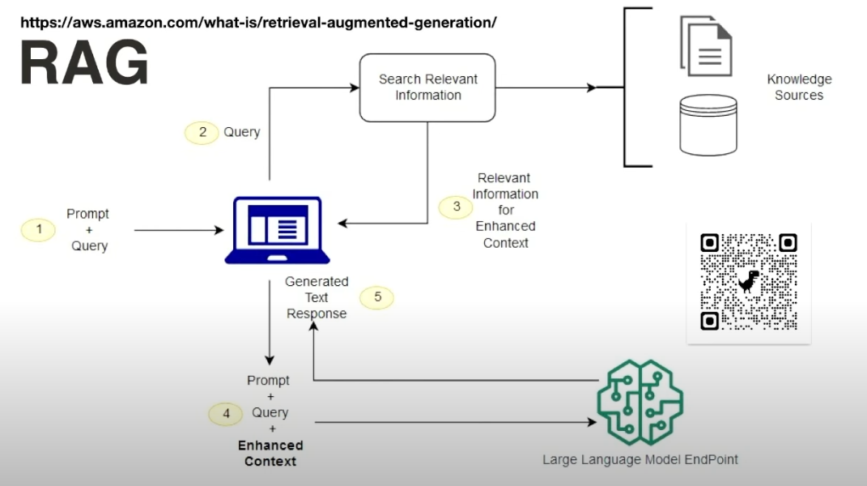
Building AI Powered Applications with Java, by Andres Almiray
Vector DB

Slide 11
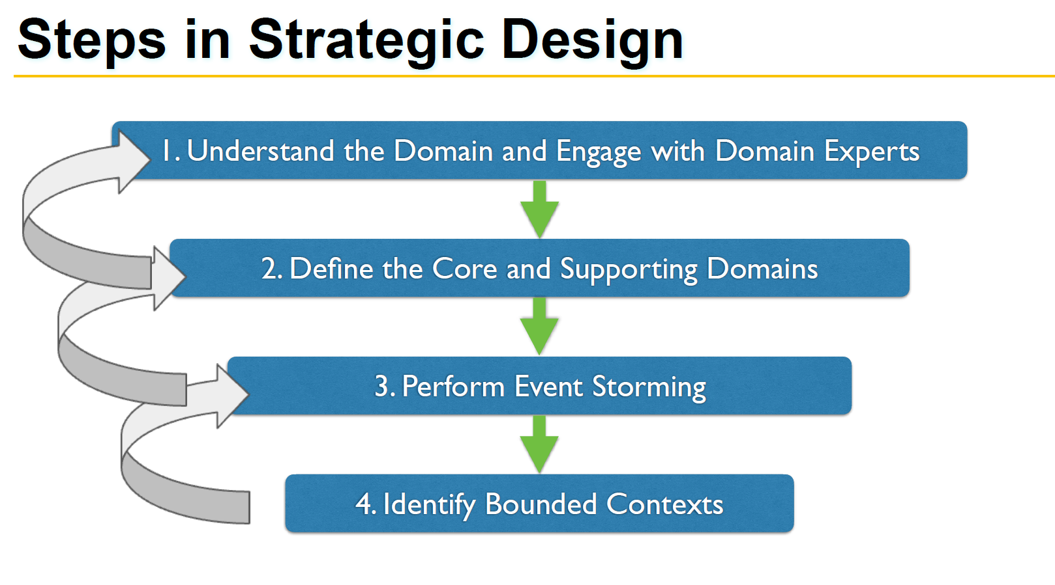
Domain Driven Design in Practice - a Java Perspective, Frederieke Scheper

Slide 12
Encryption in era of Quantum Computing
“I estimate that a 2048-bit RSA integer could be factored in under a week by a quantum computer with fewer than one million noisy qubits,” Google quantum researcher Craig Gidney
So far the number of qubits are not enough
Java 24 Strengthens Security with Quantum-Resistant Algorithms

Slide 13
Closing : Management
Mircromanagement
wfh and remote team members interaction
Culture differences between members of the team.

Slide 14
References:
https://www.youtube.com/@DATAMINERLT:
https://www.youtube.com/playlist?list=PLqYhGsQ9iSEq0as7IrlzX1aytIyMrjCuM
https://www.youtube.com/playlist?list=PLqYhGsQ9iSEowdzrnwh2fR16J0v_YblY9
https://www.youtube.com/playlist?list=PLqYhGsQ9iSEqlkm7rKtIvO7RZVjifKm-v
https://www.youtube.com/watch?v=Nj3thZnqRYQ
https://www.youtube.com/watch?v=0vyUsx5nAJQ
https://www.youtube.com/watch?v=v5jFqTN4G-0
https://www.youtube.com/watch?v=S7n2_JzB4pQ

